Slide 1

Yzv 211e – introduction to data science and engineering The possible correlation between internet usage and different health issues
150200343 – Aybike Battal
150220747 – Ilayda Kara
150220925 – Nazrin Abdinli

Slide 2
Problem Definition
Analyzing the possible relation between the internet usage and its possible influences such as health problems and changes in daily routines of children in Turkey

Slide 3
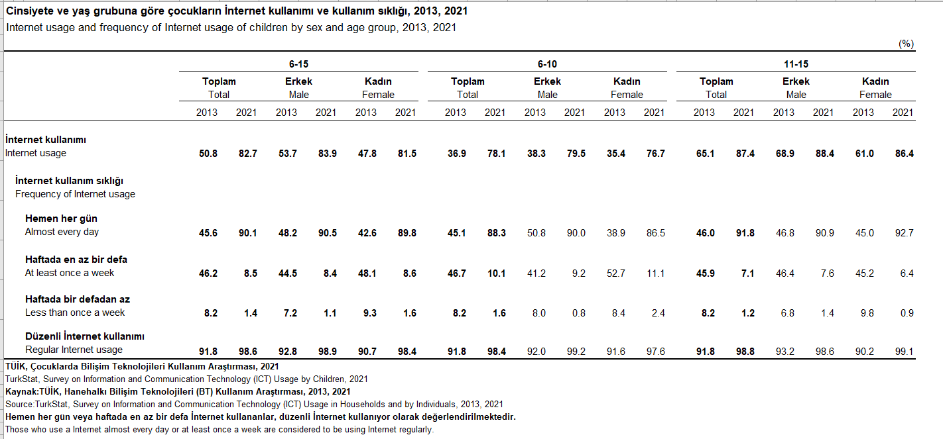
Datasets and Sources
TUIK - Internet usage and frequency of Internet usage of children by sex and age group, 2013, 2021.
This data will be used for accessing the information of internet usage of children from age group 6-15.

Slide 4
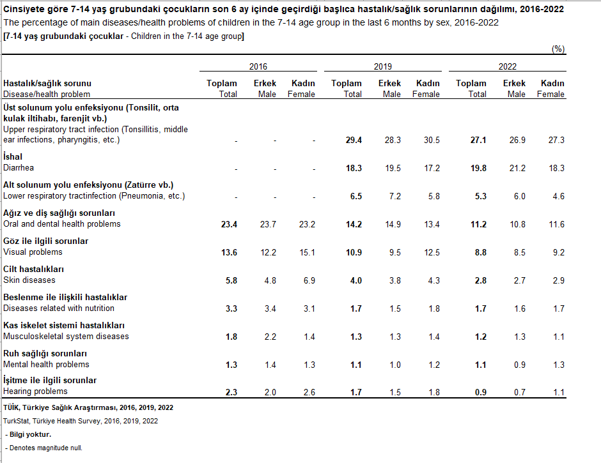
TUIK - The percentage of main diseases/health problems of children in the last 6 months by sex, 2016-2022
This data will be used for accessing the information of health problems such as visual problems, musculoskeletal system diseases, and mental health problems of children from age group 7-14

Slide 5
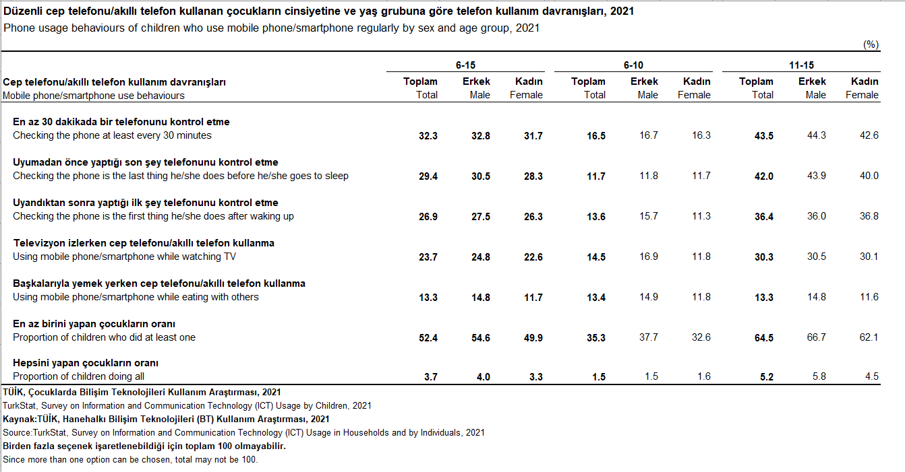
TUIK – Phone usage behaviors of children who use mobile phone/smartphone regularly by sex and age group, 2021
This data will be used for accessing the information of mobile phone usage behaviors of children from age group 6-15 such as checking the phone at least every 30 minutes which can be considered as an addiction.

Slide 6
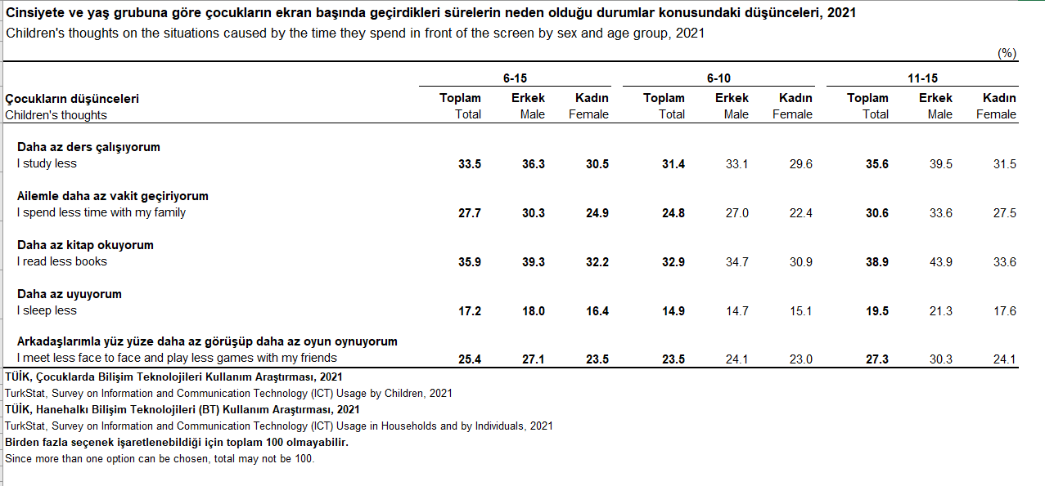
TUIK – Children's thoughts on the situations caused by the time they spend in front of the screen by sex and age group, 2021
This data will be used for analyzing the effects of increased internet usage such as studying less and spending less time with family and friends

Slide 7
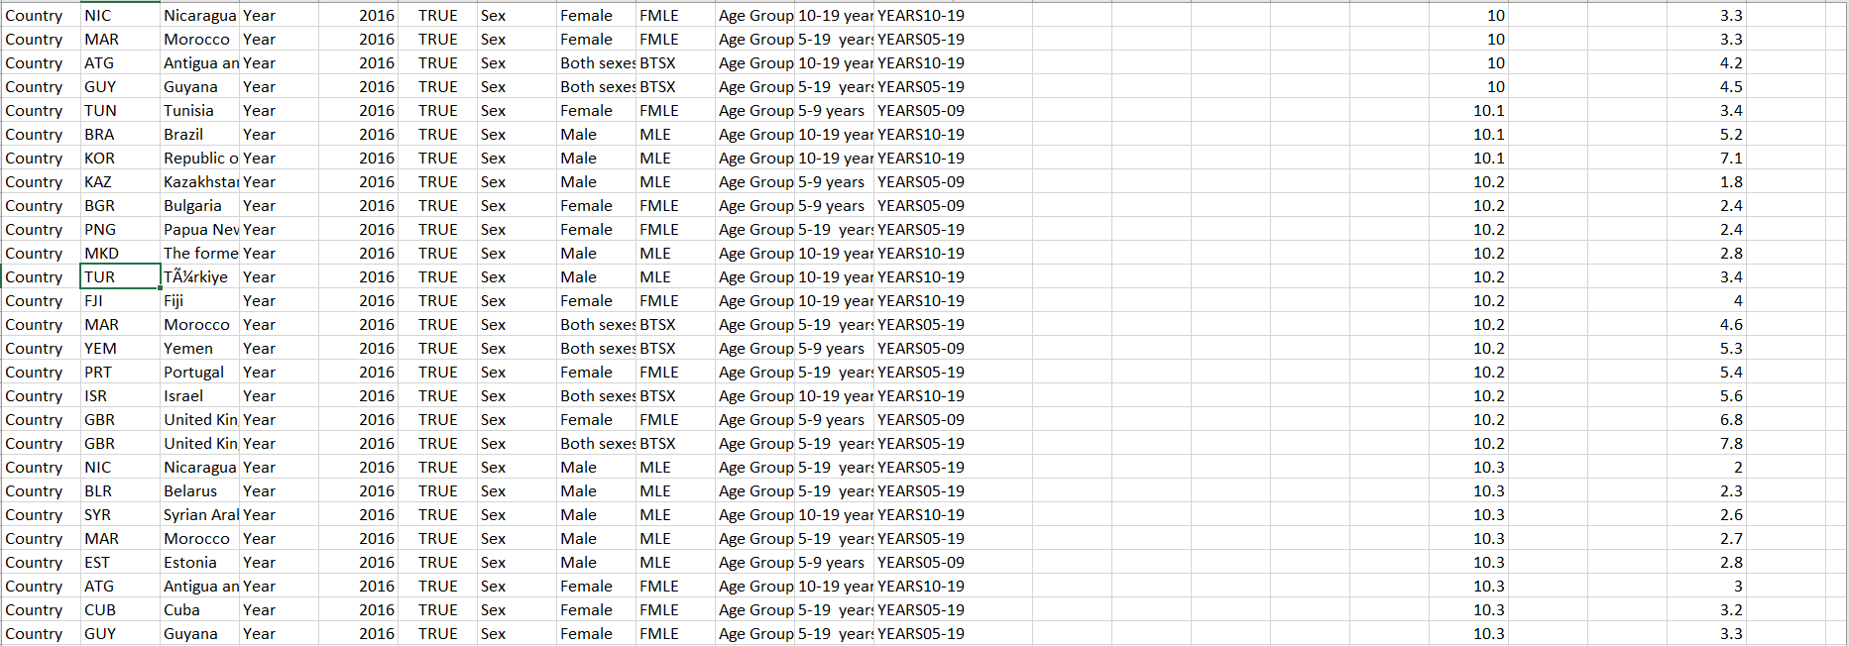
World Health Organization – Prevalence of obesity among children and adolescents, BMI > +2 standard deviations above the median (crude estimate) (%)
This data shows the obesity rates among various age groups of children in different countries from 2005 to 2016. The data for Turkey will be used to investigate the relation between obesity and internet usage.

Slide 8
How the datasets and sources are merged?
The Internet Usage dataset is used as the main data. For investigating the relationship between internet usage and health issues, it is merged with other datasets.

Slide 9
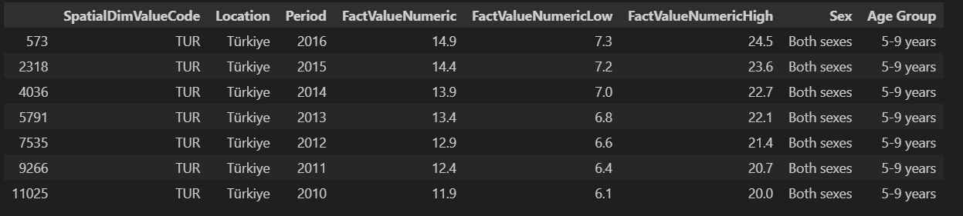
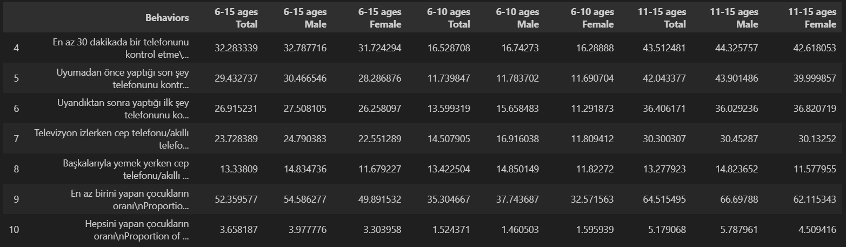
EDA
Some examples of DataFrames and visualizations from the project:
DataFrame of Obesity Rates from 5-9 age group of both sexes between 2010 and 2016 in Turkey
DataFrame of different behaviors from different age groups and genders in 2021

Slide 10
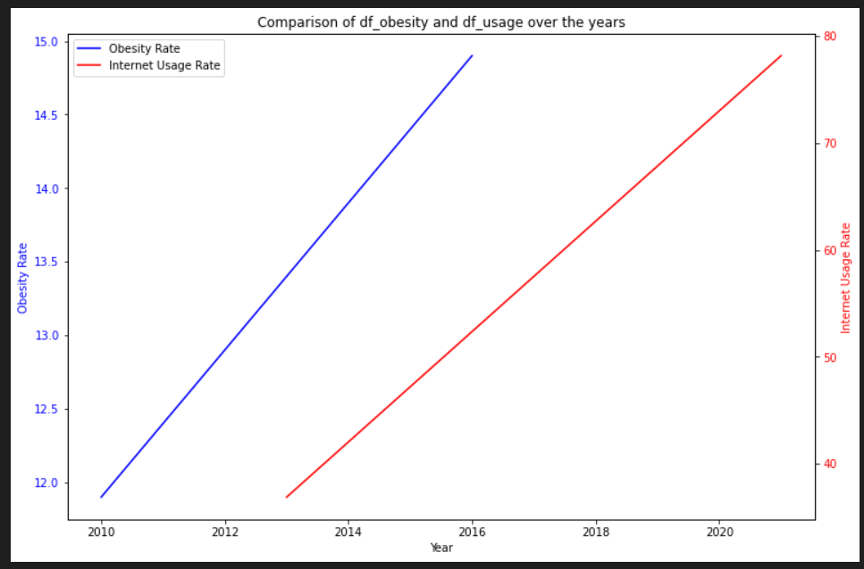
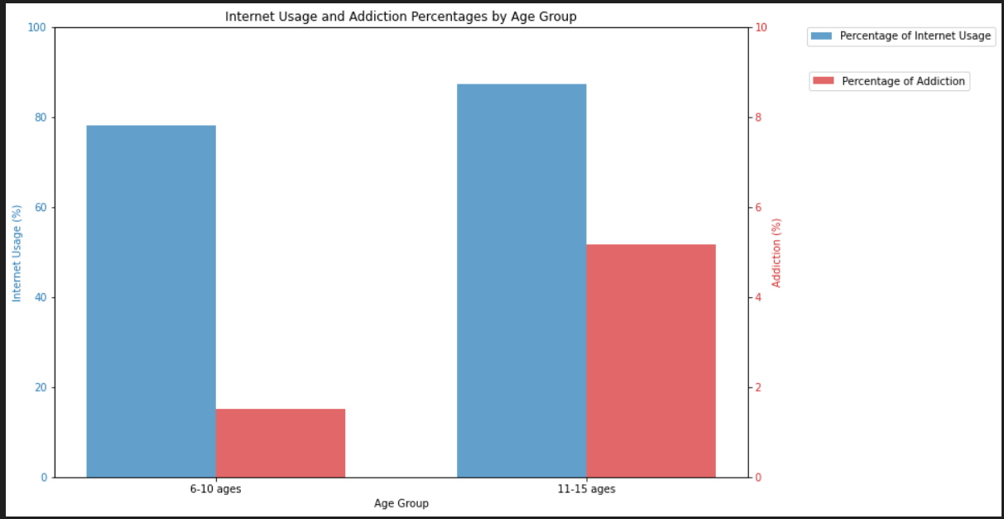
Graph Showing the Correlation of Obesity and Internet Usage
The Graph Showing the Correlation of Addiction Behaviors and Internet Usage

Slide 11
Research Questions
Is there a relationship between the rate of internet usage and obesity rates in children?
Hypothesis: While the Internet Usage rate increases, the obesity rate increases.
The percentage of the internet usage in age group 6-10 in 2021 is higher than that in 2013. Meanwhile, the obesity rate in age group 5-9 in 2016 is also higher than that in 2010. When the graph is interpreted, it can be seen that both lines show increasing trend between 2013 and 2016. In this case, there is possibility that increased obesity rate is related to increased internet usage.

Slide 12
Does the increase in internet usage by children also lead them to become addicted to mobile devices?
Hypothesis: While the Internet Usage rate increases, children become more addicted to technological devices.
The percentage of the internet usage in age group 11-15 is higher than that in age group 6-10. Meanwhile, the addiction percentage in age group 11-15 is also higher than that in age group 6-10. In this case, the graph supports our hypothesis and there is possibility that addiction is related to increased internet usage.

Slide 13
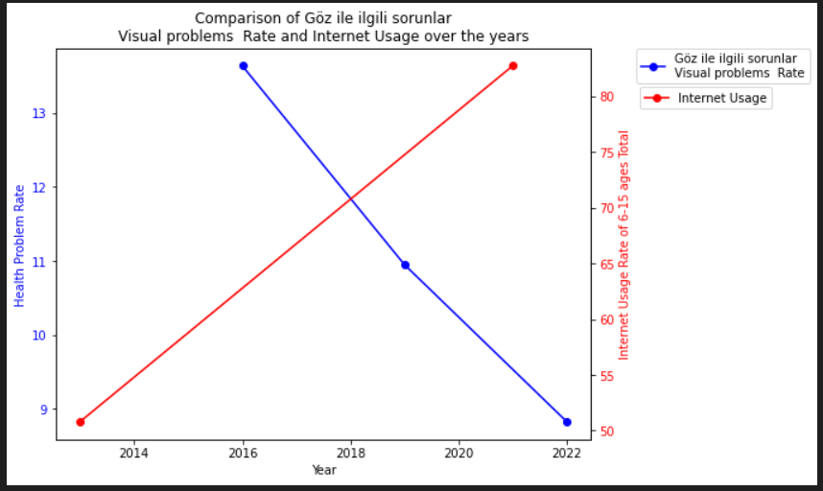
Have physical and mental diseases increased with the increase in internet usage by children?
Hypothesis 1: While the Internet usage rate increases, the visual problems rate also increases.
The percentage of the internet usage in age group 6-15 in 2021 is higher than that in 2013. On the contrary, the visual problems rate in age group 7-14 in 2022 is lower than that in 2016. When the graph is interpreted, it can be seen that while the line representing internet usage rate shows increasing trend between 2013 and 2021, the line representing visual problems rate shows decreasing trend. In this case, contrary to hypothesis 1, it cannot be claimed that visual problems are directly related to increased Internet usage.

Slide 14
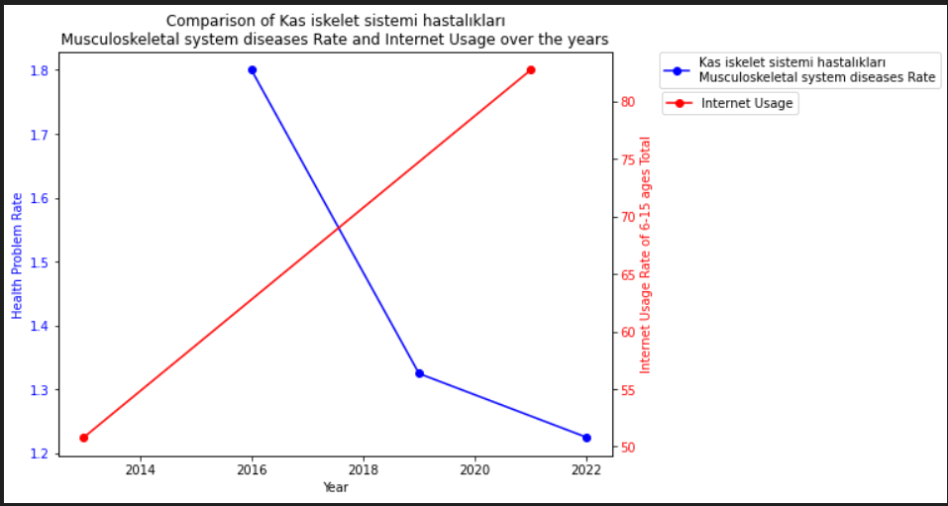
Have physical and mental diseases increased with the increase in internet usage by children?
Hypothesis 2: While the Internet usage rate increases, the musculoskeletal system diseases rate also increases.
The percentage of the internet usage in age group 6-15 in 2021 is higher than that in 2013. On the contrary, the musculoskeletal system diseases rate in age group 7-14 in 2022 is lower than that in 2016. When the graph is interpreted, it can be seen that while the line representing internet usage rate shows increasing trend between 2013 and 2021, the line representing musculoskeletal system diseases rate shows decreasing trend. In this case, contrary to hypothesis 2, it cannot be claimed that musculoskeletal system diseases are directly related to increased Internet usage.

Slide 15
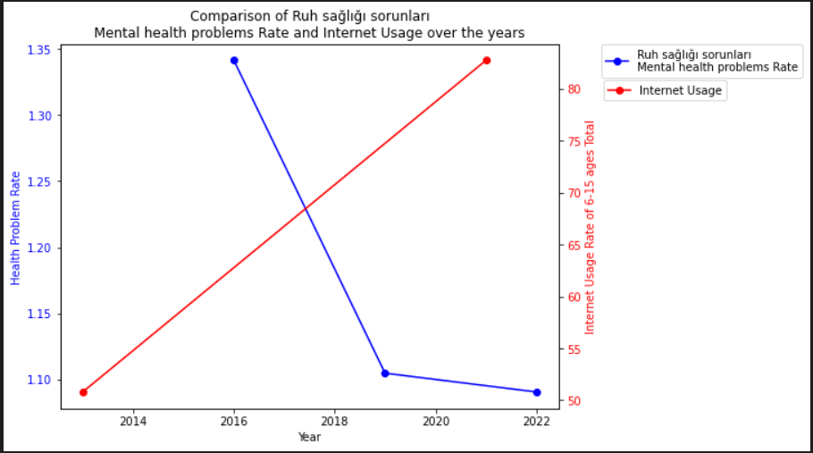
Have physical and mental diseases increased with the increase in internet usage by children?
Hypothesis 3: While the Internet usage rate increases, the mental health problems rate also increases.
The percentage of the internet usage in age group 6-15 in 2021 is higher than that in 2013. On the contrary, the mental health problems rate in age group 7-14 in 2022 is lower than that in 2016. When the graph is interpreted, it can be seen that while the line representing internet usage rate shows increasing trend between 2013 and 2021, the line representing the mental health problems rate shows decreasing trend. In this case, contrary to hypothesis 3, it cannot be claimed that the mental health problems are directly related to increased Internet usage.

Slide 16
Proposed Tests and Questions
Does increased Internet usage influence daily lives of children in terms of their academic performance and social skills?
Hypothesis: Increasing Internet usage has negative effects on children in terms of academic performance and social skills.
Which gender is more influenced in terms of addiction by the increase of Internet usage?
Hypothesis: Males are more influenced in terms of addiction by the increase of Internet usage.
Which gender’s daily routine is more influenced by the increase in internet usage?
Hypothesis: Males’ daily routines are more influenced by the increase of Internet usage.

Slide 17
Potential products and Issues Related to Data Engineering
Potential Product: Parental Control and Monitoring Tools
A parental control application which allows parents to monitor and control their children's internet usage, set time limits on device usage, and receive alerts about excessive screen time can be developed. This could be a way to help to decrease addiction and obesity rate among children.
Issues of Data Engineering:
The application needs to continuously collect and monitor data related to children's internet usage, device activity, screen time, websites visited, and application usage. This requires robust data collection mechanisms that efficiently capture and process this information in real-time.
There's a need for a scalable and secure data storage solution to handle the influx of data collected from multiple users. This includes structuring the database to efficiently store and retrieve data, choosing the right database technology (SQL, NoSQL, or a combination), and implementing data encryption for security purposes.

Slide 18
Issues related ethics.
Privacy Concerns:
Gathering data on children's internet usage and device activity raises significant privacy concerns. Ensuring that the collected data is handled securely and confidentially is crucial. Implementing robust encryption, anonymization of personal information, and obtaining explicit consent from parents or legal guardians for data collection are essential ethical practices.
Transparency and Control:
Providing transparency to parents about the workings of the application, what data is being collected, and how it's being used is important. Additionally, giving users (in this case, parents and possibly children) control over their data—such as the ability to delete or modify it—is an ethical imperative.

Slide 19
Conclusion
This project aims to examine the potential relationship between internet use and its effects, such as health issues and alterations to kids' daily routines in Turkey
According to the analysis, it is found that while internet usage is increasing across age groups, in parallel, addiction to mobile devices is also increasing.
Additionally, while the internet usage rate is increasing over years, it is seen that obesity rate is increasing too. It can be said that, there might be a correlation between them. These two analyzes have showed a result consistent with our hypotheses.
For the last research question, the relationship between internet usage and visual problems, musculoskeletal system diseases, and mental health problems is examined and opposite to our hypothesis, it is showed that there is negative correlation between them.
Finally, for the potential product, it is possible to create a parental control software that enables parents to keep an eye on and regulate their kids' internet usage, establish time restrictions for device usage, and get notifications when their kids spend too much time in front of the screen. This may serve as a means of reducing childhood obesity and addiction.

